Slide 1
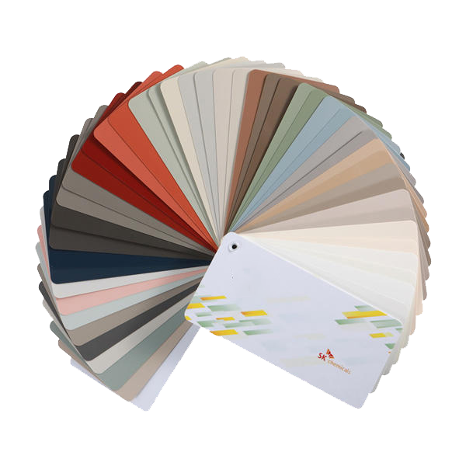


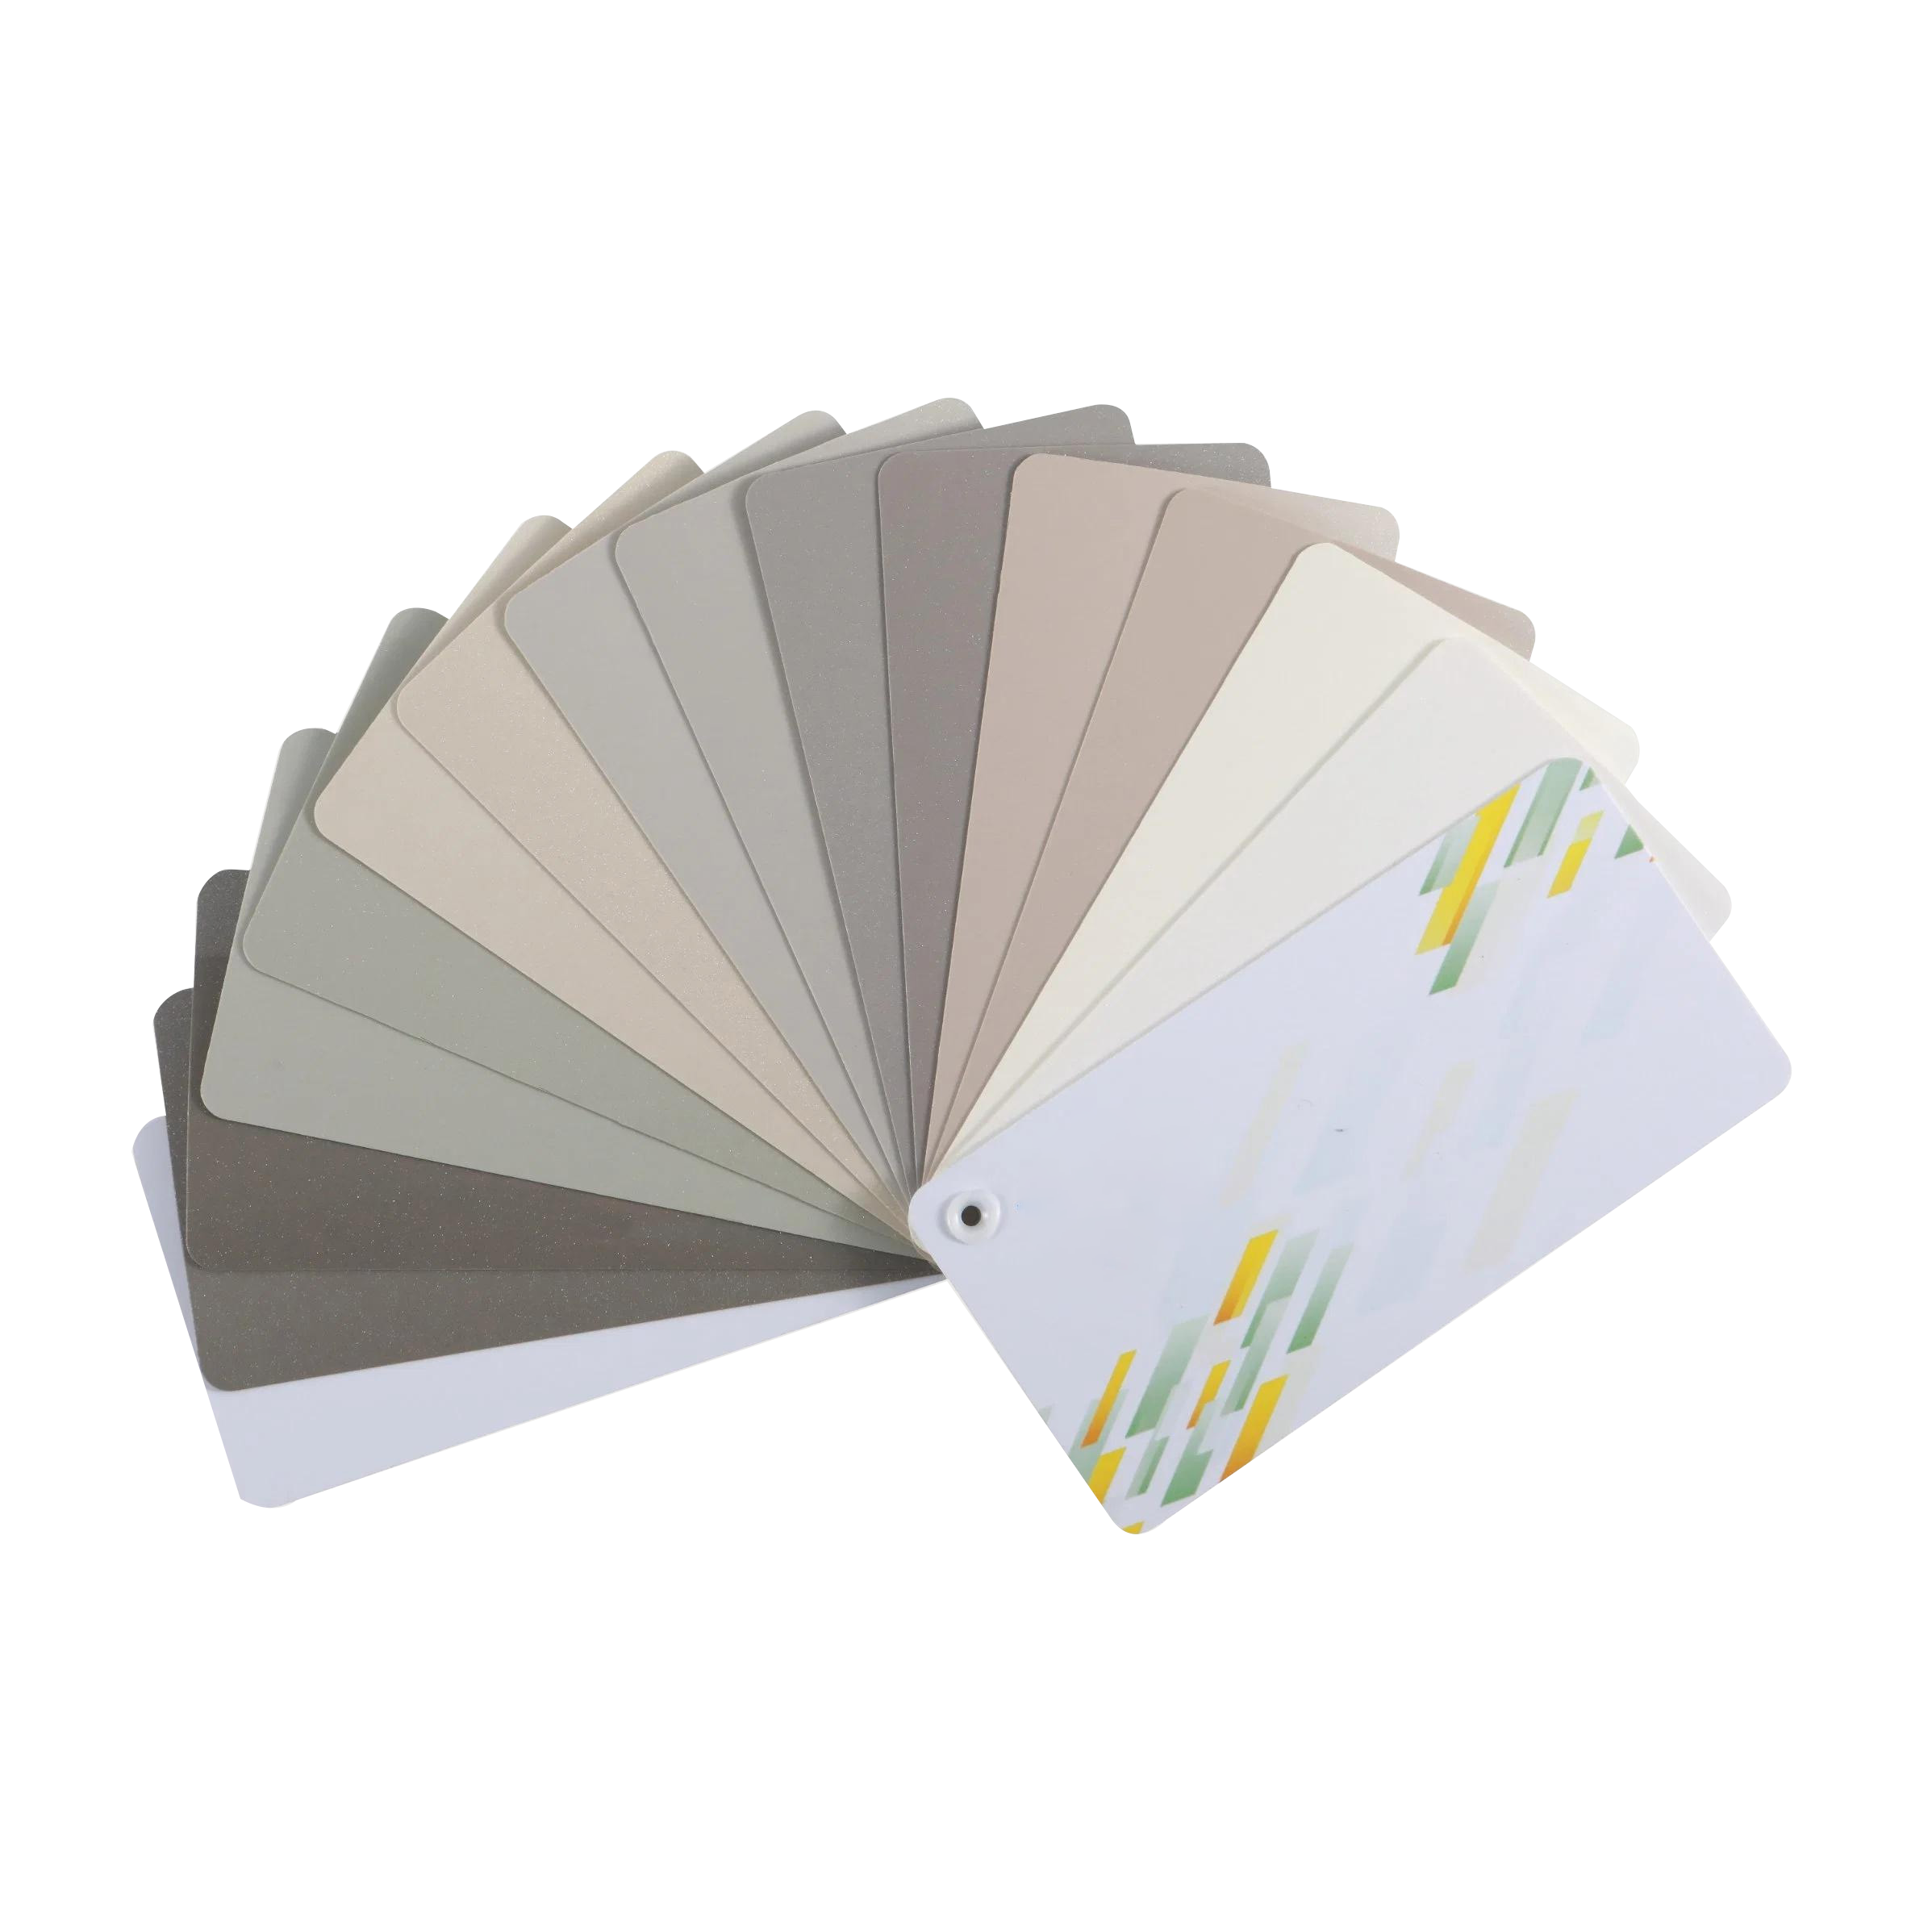
2024
WALLIS
PETG Product Summary
SHANGHAIWALLISTECHNOLOGYCO.,LTD

Slide 2
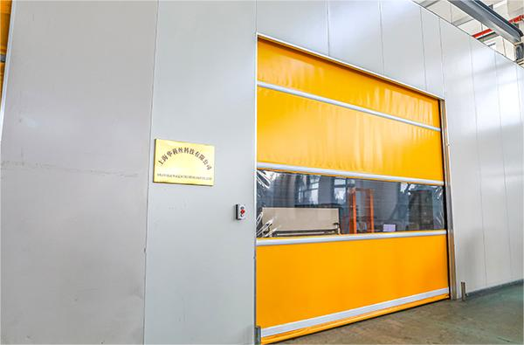
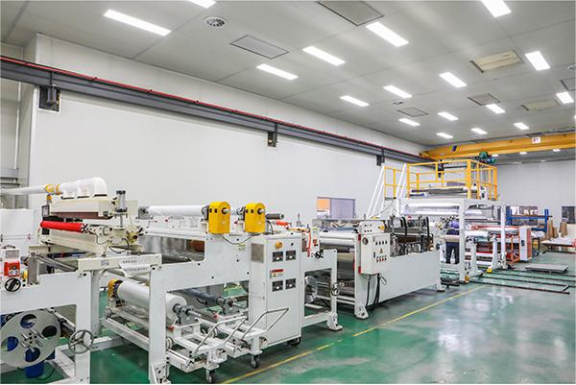
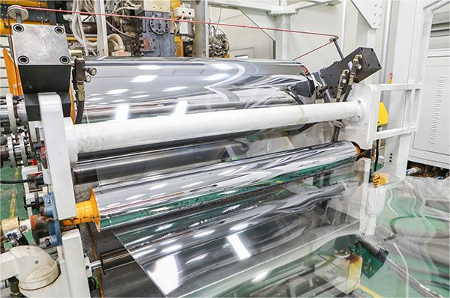
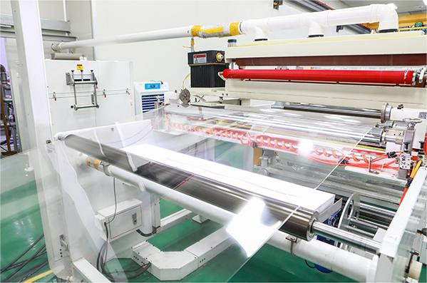
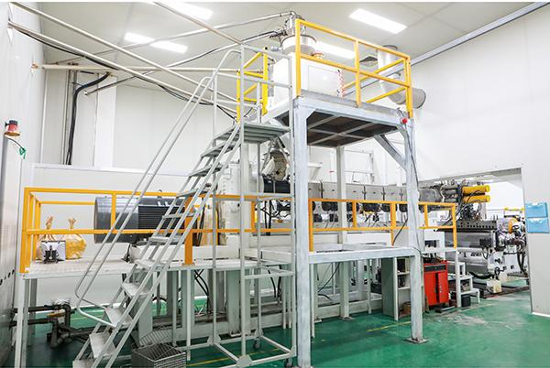
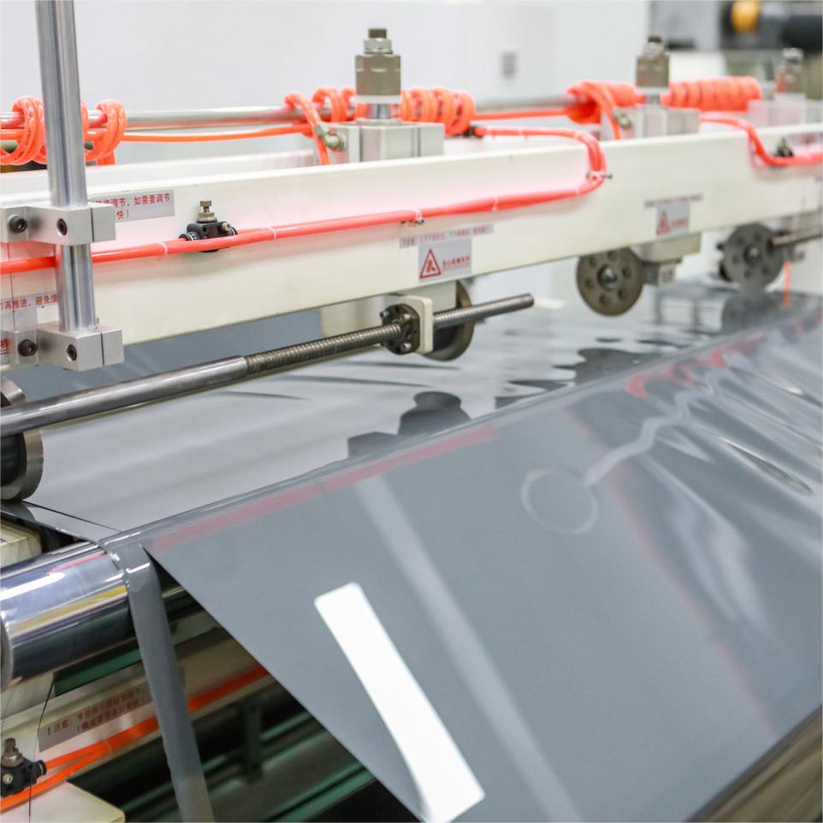
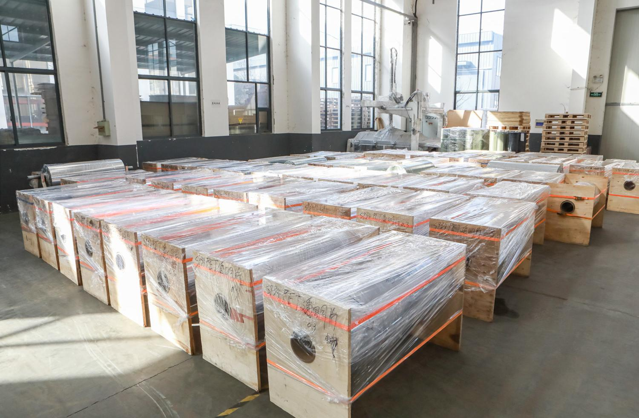
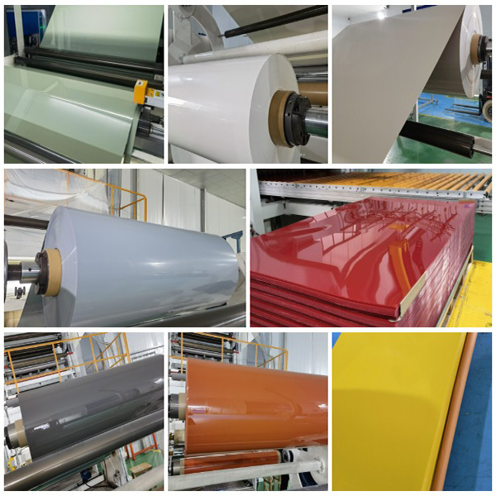
Factory Show

Slide 3
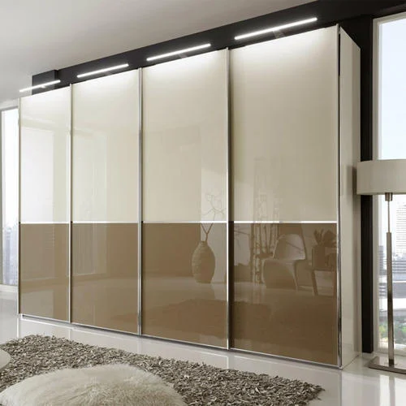
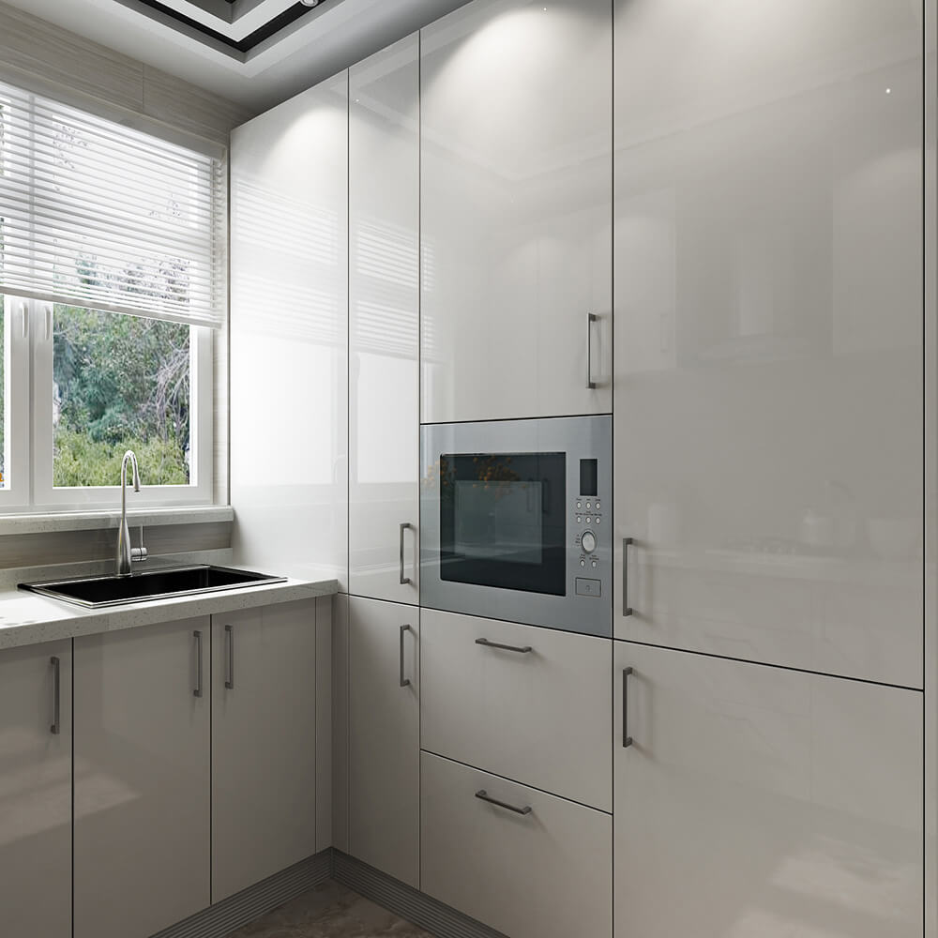
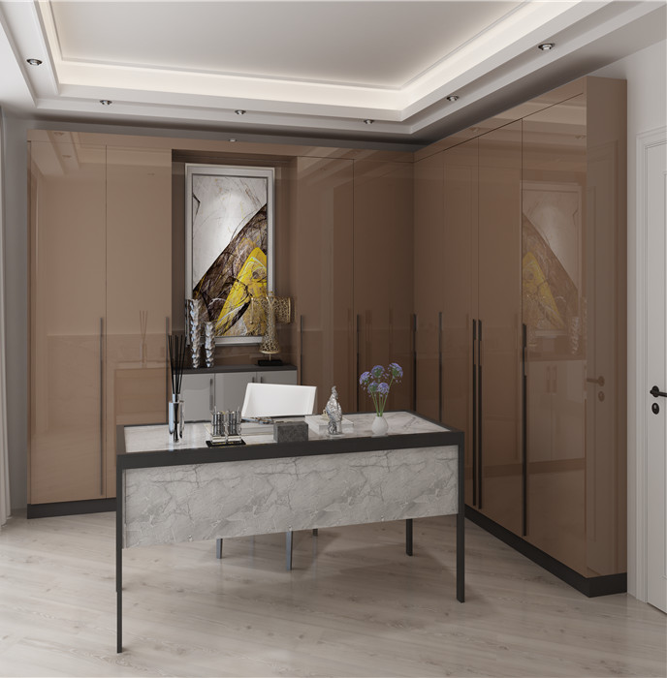

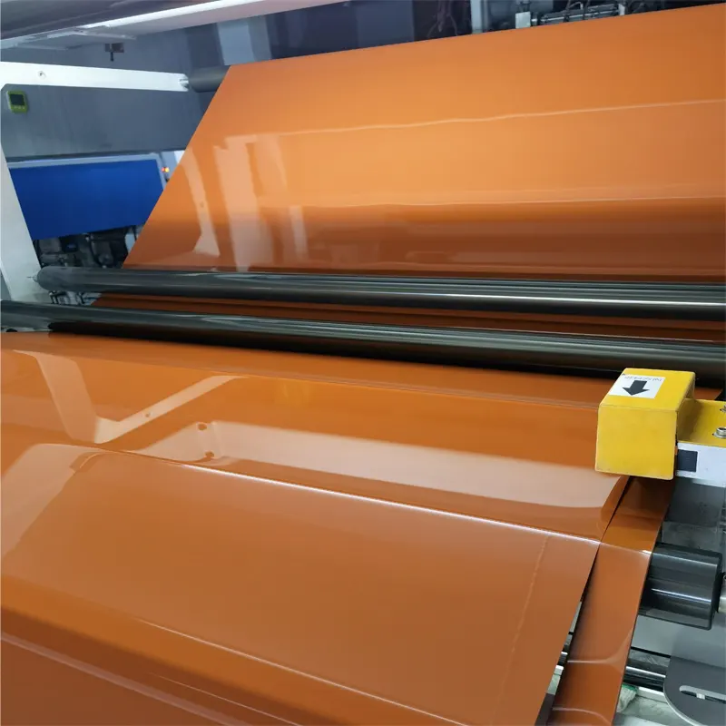
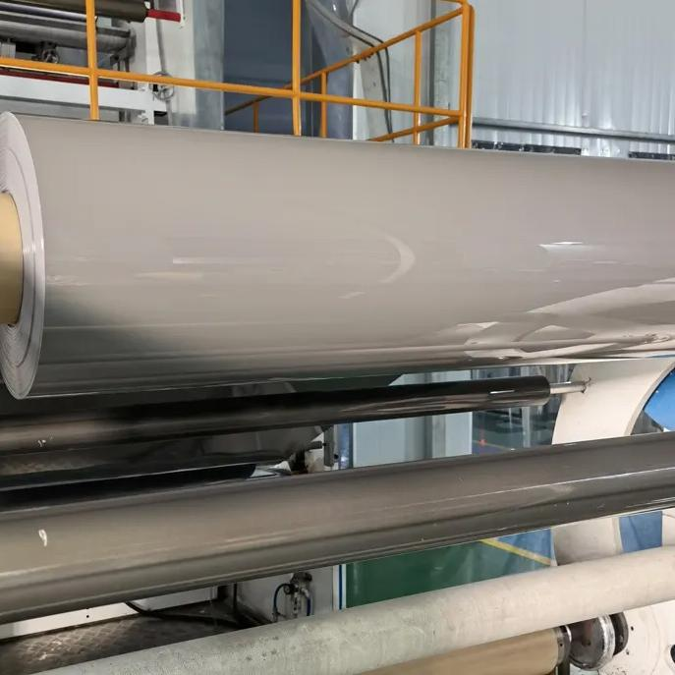
01
GLOSS PETG

Slide 4










01 GLOSS PETG
WLS-0001-G
ICEBERG WHITE
WLS-0002-G
IVORY WHITE
WLS-0003-G
CREAM
WLS-0004-G
TWILIGHT GRAY
WLS-0005-G
EARTH BROWN
WLS-0006-G
WHEAT
WLS-0007-G
PURE GRAY
WLS-0008-G
FANTASY BLUE
WLS-0009-G
OLIVE GREEN
WLS-0010-G
SPACE GRAY

Slide 5










01 GLOSS PETG
WLS-0011-G
COFFEE LATTE
WLS-0013-G
ACACIA GRAY
WLS-0014-G
MILAN GRAY
WLS-0015-G
IVORY GRAY
WLS-0016-G
CARDAMOM GREEN
WLS-0017-G
PUMPKIN RED
WLS-0019-G
PINE GRAY
WLS-0020-G
GENTLEMAN GRAY
WLS-0021-G
SAPPHIRE BLUE
WLS-0022-G
WISDOM BLACK

Slide 6



01 GLOSS PETG
WLS-0023-G
LIGHT GRAY
WLS-0027-G
MODERN GRAYY
WLS-0030-G
CRYSTAL GRAY

Slide 7
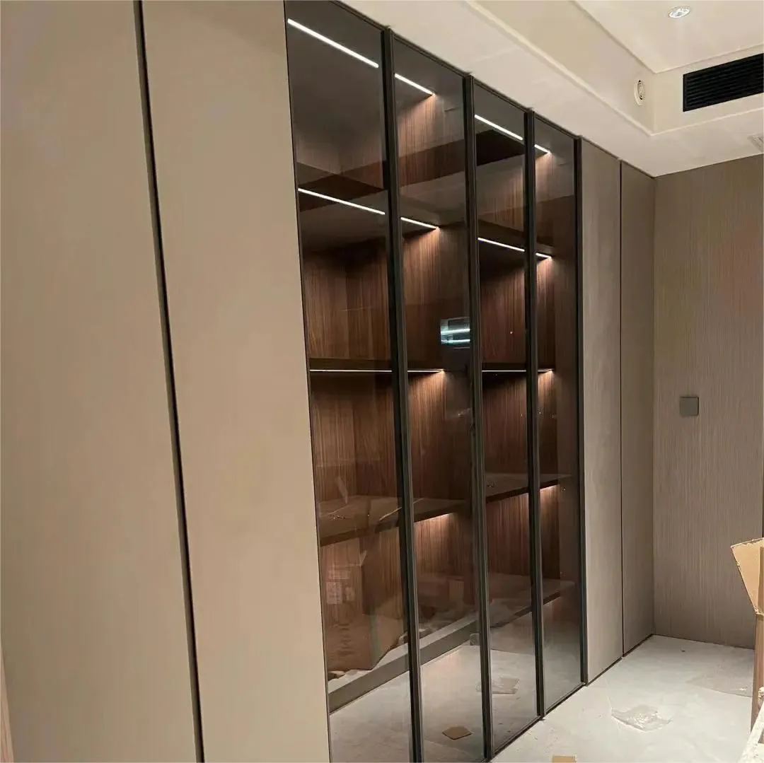
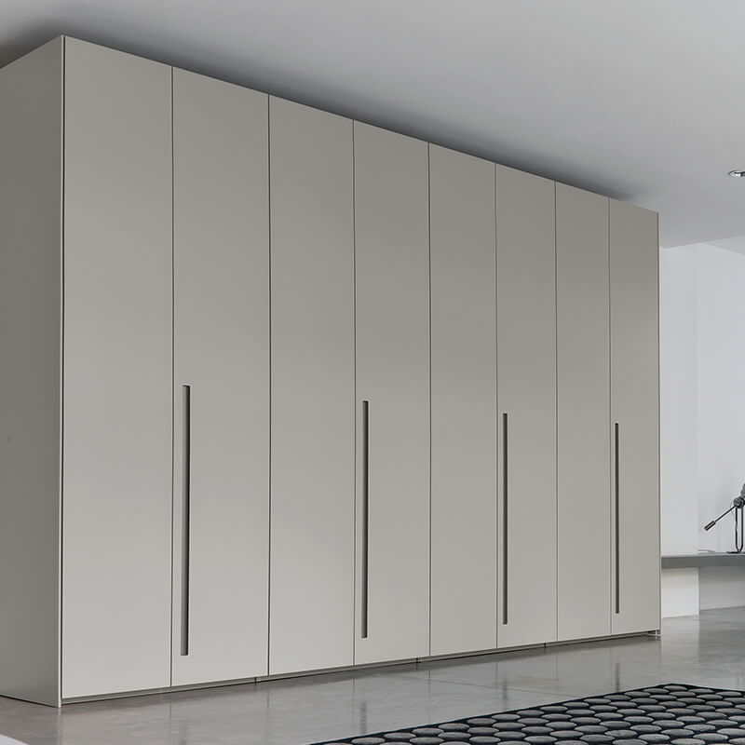
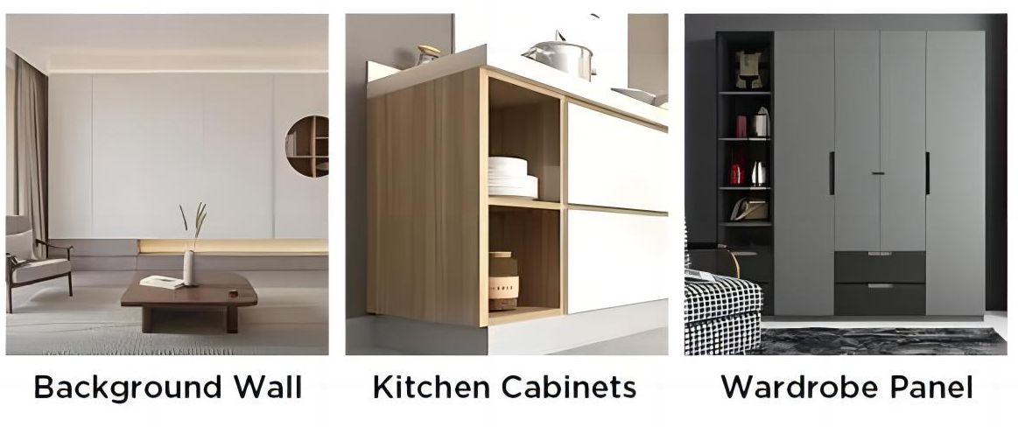


02
MATT PETG

Slide 8






02 MATT PETG
WLS-0001-M
ICEBERG WHITE
WLS-0002-M
IVORY WHITE
WLS-0003-M
CREAM
WLS-0004-M
TWILIGHT GRAY
WLS-0005-M
EARTH BROWN
WLS-0006-M
WHEAT
WLS-0007-M
PURE GRAY
WLS-0008-M
FANTASY BLUE
WLS-0009-M
OLIVE GREEN
WLS-0010-M
SPACE GRAY

Slide 9










02 MATT PETG
WLS-0011-M
COFFEE LATTE
WLS-0013-M
ACACIA GRAY
WLS-0014-M
MILAN GRAY
WLS-0015-M
IVORY GRAY
WLS-0016-M
CARDAMOM GREEN
WLS-0017-M
PUMPKIN RED
WLS-0018-M
CARMINE RED
WLS-0019-M
PINE GRAY
WLS-0020-M
GENTLEMAN GRAY
WLS-0021-M
SAPPHIRE BLUE

Slide 10










02 MATT PETG
WLS-0022-M
WISDOM BLACK
WLS-0023-M
LIGHT GRAY
WLS-0024-M
BARBIE PINK
WLS-0025-M
MORNING BLUE
WLS-0026-M
PEPPER ASH
WLS-0027-M
MODERN GRAY
WLS-0030-M
CRYSTAL GRAY
WLS-0031-M
JADE GREEN
WLS-0032-M
DESERT GRAY
WLS-0036-M
MILKY WHITE

Slide 11


02 MATT PETG
WLS-0037-M
SILK WHITE
WLS-0038-M
ALMOND YELLOW

Slide 12
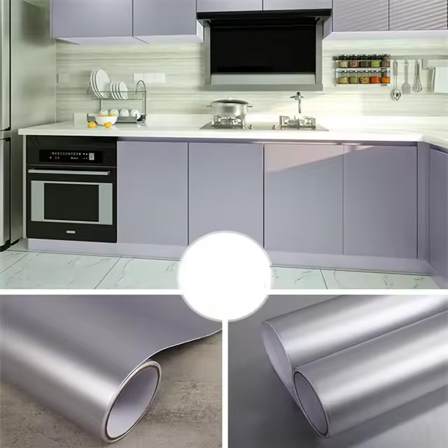
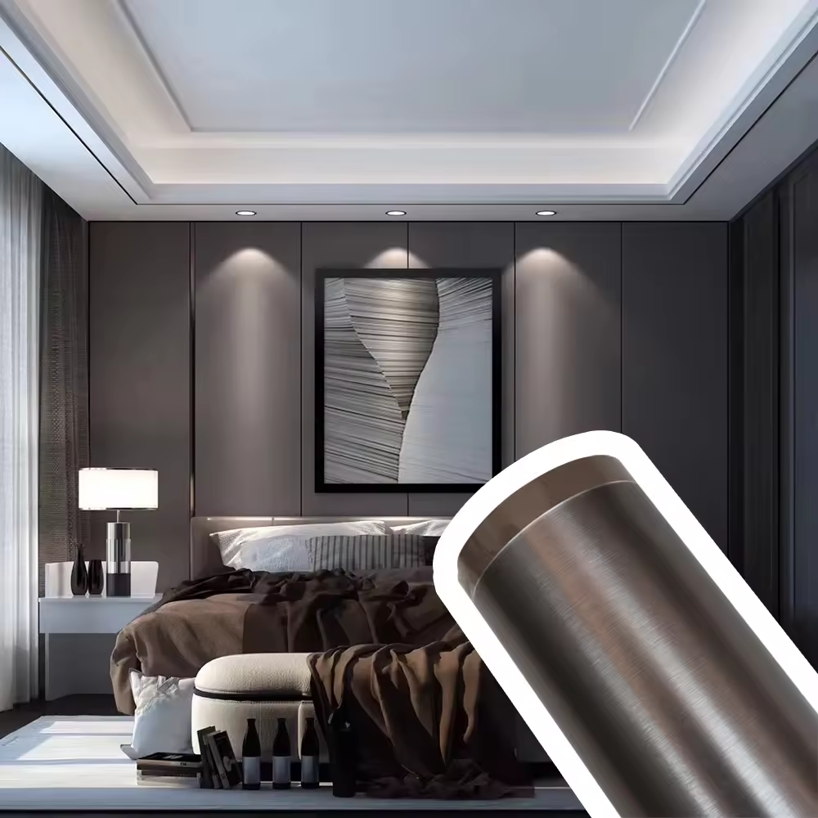
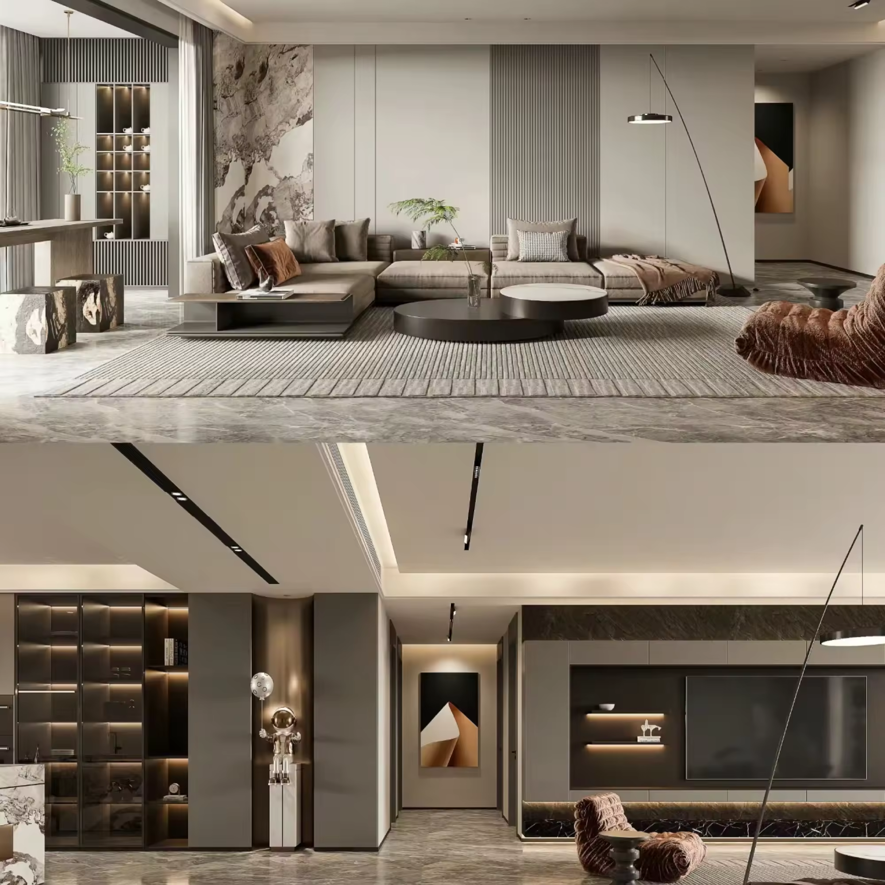
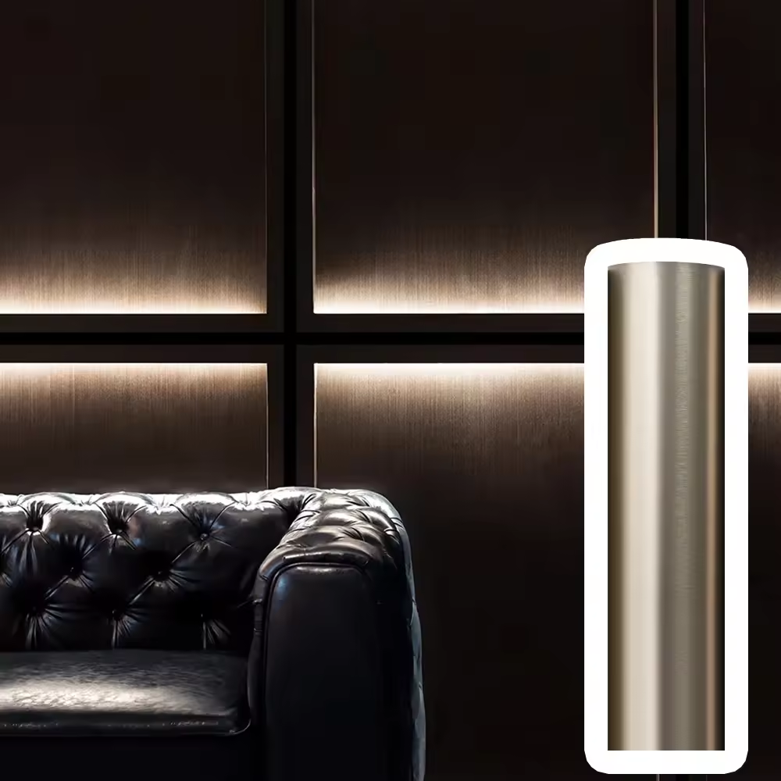
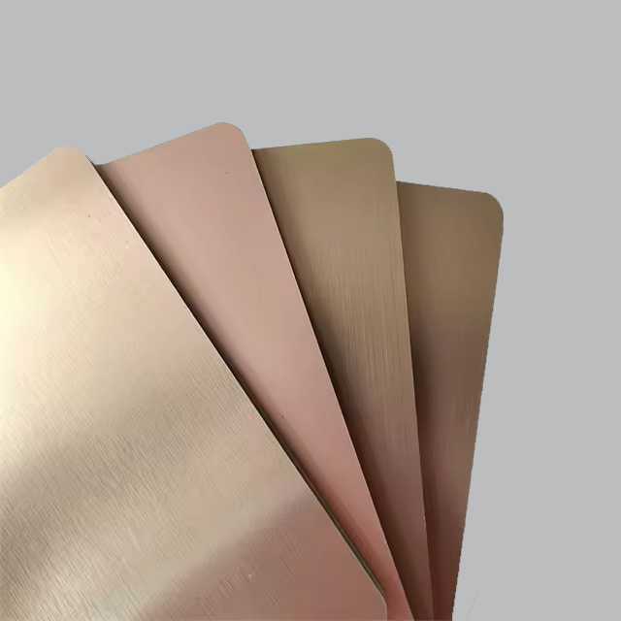
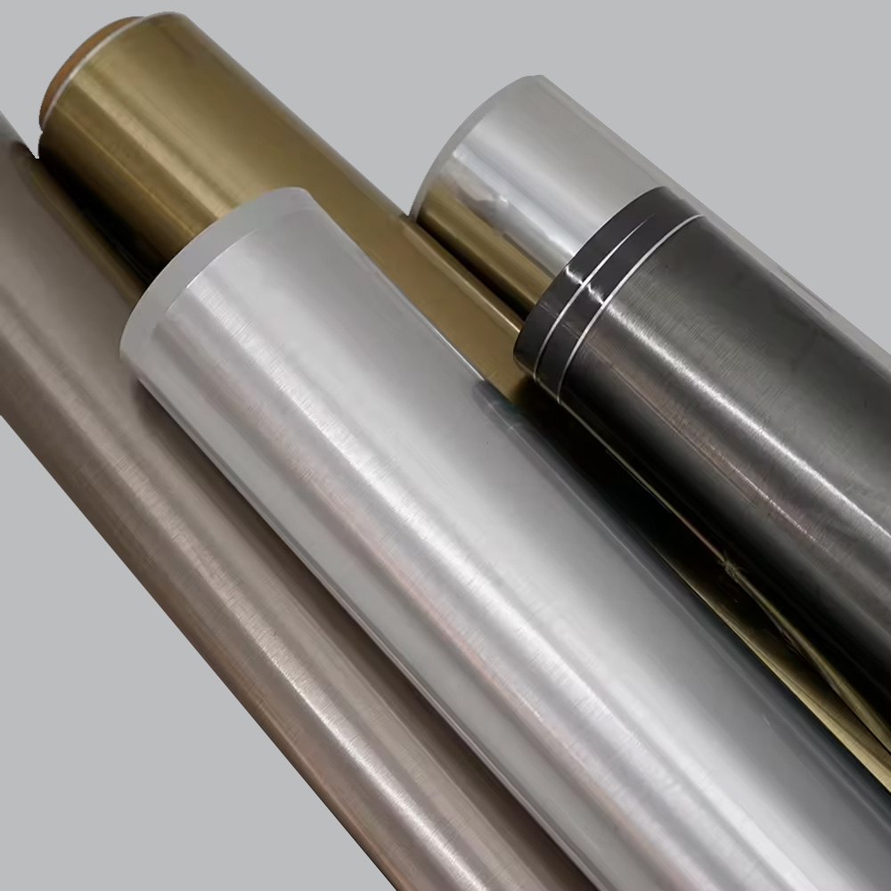
03
METALLIC PETG

Slide 13










03 METALLIC PETG
WLS-0001-GJ
ICEBERG WHITE GLOSS
WLS-0001-MJ
ICEBERG WHITE MATT
WLS-0002-GJ
IVORY WHITE GLOSS
WLS-0002-MJ
IVORY WHITE MATT
WLS-0003-GJ
CREAM GLOSS
WLS-0003-MJ
CREAM MATT
WLS-0004-GJ
TWILIGHT GRAY GLOSS
WLS-0004-MJ
TWILIGHT GRAY MATT
WLS-0005-GJ
EARTH BROWN GLOSS
WLS-0005-MJ
EARTH BROWN MATT

Slide 14










03 METALLIC PETG
WLS-0006-GJ
WHEAT GLOSS
WLS-0006-MJ
WHEAT MATT
WLS-0015-GJ
IVORY GRAY GLOSS
WLS-0015-MJ
IVORY GRAY MATT
WLS-0016-GJ
CARDAMOM GREEN GLOSS
WLS-0016-MJ
CARDAMOM GREEN MATT
WLS-0039-GJ
TECH GRAY GLOSS
WLS-0039-MJ
TECH GRAY MATT
WLS-0040-GJ
GRAPHITE GRAY GLOSS
WLS-0040-MJ
GRAPHITE GRAY MATT

Slide 15






03 METALLIC PETG
WLS-00041-GJ
ROMANCE RED GLOSS
WLS-0041-MJ
ROMANCE RED MATT
WLS-0042-GJ
BRONZE GOLD GLOSS
WLS-0042-MJ
BRONZE GOLD MATT
WLS-0043-GJ
EMERALD GLOSS
WLS-0043-MJ
EMERALD MATT

Slide 16
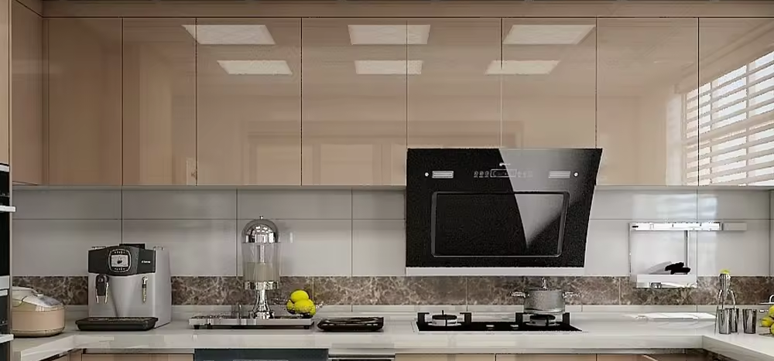
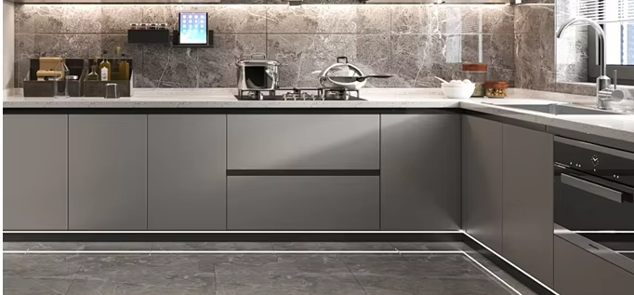
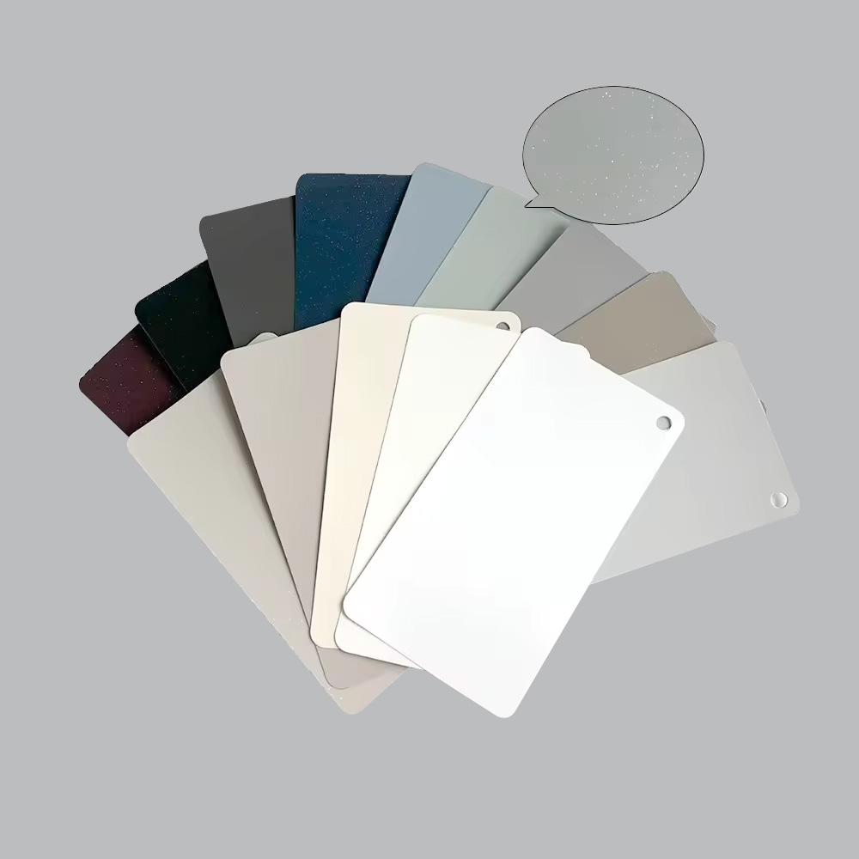

04
PEARLESCENT (GLITTER) PETG

Slide 17










04 PEARLESCENT (GLITTER) PETG
WLS-0001-GZ-1
ICEBERG WHITE GLOSS
WLS-0002-GZ-1
IVORY WHITE GLOSS
WLS-0002-MZ-1
IVORY WHITE MATT
WLS-0004-GZ-1
TWILIGHT GRAY GLOSS
WLS-0004-MZ-1
TWILIGHT GRAY MATT
WLS-0007-GZ-1
PURE GRAY GLOSS
WLS-0007-MZ-1
PURE GRAY MATT
WLS-0014-GZ-1
MILAN GRAY GLOSS
WLS-0014-MZ-1
MILAN GRAY MATT
WLS-0015-GZ-1
IVORY GRAY GLOSS

Slide 18





04 PEARLESCENT (GLITTER) PETG
WLS-0015-MZ-1
IVORY GRAY MATT
WLS-0016-GZ-1
CARDAMOM GREEN GLOSS
WLS-0016-MZ-1
CARDAMOM GREEN MATT
WLS-0019-GZ-2
PINE GRAY GLOSS
WLS-0019-MZ-2
PINE GRAY MATT

Slide 19
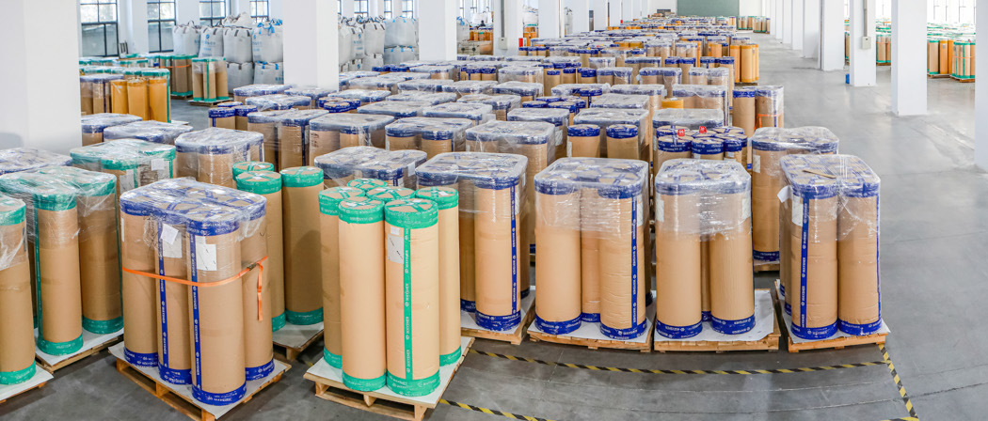
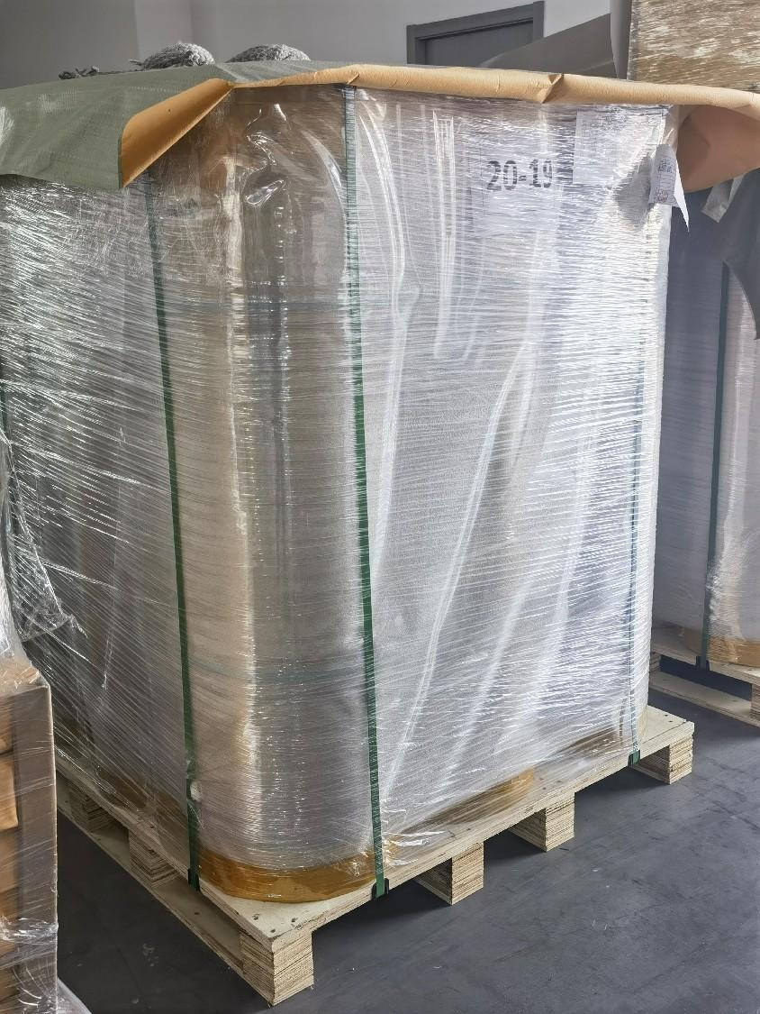

Packing and Roading

